Slide 1


Slide 2
Introduction
Apache Pig is a high-level data flow platform for executing MapReduce programs of Hadoop.
The language used for Pig is Pig Latin.
The Pig scripts get internally converted to Map Reduce jobs and get executed on data stored in HDFS.
Pig can handle any type of data, i.e., structured, semi-structured or unstructured data.

Slide 3
Features
Ease of programming
Rich set of operators
Optimization opportunities
Extensibility
create User-defined Functions
Handles all kinds of data

Slide 4
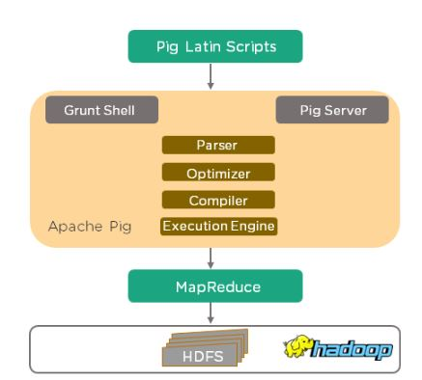
Architecture
Fig. Pig Architecture

Slide 5
Pig Running Modes
Apache Pig executes in two modes: Local Mode and MapReduce Mode.
Local Mode
It executes in a single JVM and is used for development experimenting and prototyping.
Here, files are installed and run using localhost.
The local mode works on a local file system. The input and output data stored in the local file system.
$ pig-x local

Slide 6
Contd…
MapReduce Mode
The MapReduce mode is also known as Hadoop Mode.
It is the default mode.
Pig renders Pig Latin into MapReduce jobs and executes them on the cluster.
It can be executed against semi-distributed or fully distributed Hadoop installation.
Here, the input and output data are present on HDFS.
$pig OR $pig -x mapreduce

Slide 7
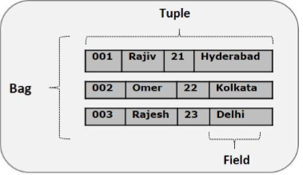
Pig Latin Data Type
A piece of data or a simple atomic value is known as field.
A tuple is an ordered set of fields.
A bag is a collection of tuples

Slide 8
Pig Latin Conventions
Convention | Description
( ) | The parenthesis can enclose one or more items. Used to indicate the tuple data type. Example - (10, xyz, (3,6,9))
[ ] | The straight brackets can enclose one or more items. Used to indicate the map data type. Example - [INNER | OUTER] [name#Raja, age#30]
{ } | The curly brackets enclose two or more items. Used to indicate the bag data type Example - { block | nested_block } {Raja, 30, {9848022338, raja@gmail.com,}}
... | The horizontal ellipsis points indicate that you can repeat a portion of the code. Example - cat path [path ...]

Slide 9
PIG Relational Operators
LOAD
CROSS
DISTINCT
FILTER
FOR EACH
GROUP
LIMIT
ORDER BY
SPLIT
UNION

Slide 10
LOAD Operator
Upload the text files on HDFS in the specific directory.
$ hdfs dfs -put pload.txt /pigexample
Open the pig MapReduce run mode.
$ pig
Load the file that contains the data.
grunt> A = LOAD '/pigexample/pload.txt' USING PigStorage(',') AS (a1:int,a2:int,a3:int,a4:int) ;
Execute and verify the data.
grunt> DUMP A;
grunt> DESCRIBE A;

Slide 11
LOAD Operator
Create a text file in your local machine and enter values to it.
$ nano number.txt
Check the values written in the text files.
$ cat number.txt
Upload the text files on HDFS in the specific directory.
$ hdfs dfs -put number.txt /pigdemo
Open the pig MapReduce run mode.
$ pig
Load the file that contains the data.
grunt> A = LOAD '/pigdemo/number.txt' USING PigStorage(',') AS (a1:int, a2:int, a3:int, a4:int);
Execute and verify the data.
grunt> DUMP A; grunt> DESCRIBE A;

Slide 12
CROSS Operator
Load the file that contains the data.
grunt> A = LOAD '/pigdemo/pcross1.txt' USING PigStorage(',') AS
(a1:int,a2:int);
grunt> B = LOAD '/pigdemo/pcross2.txt' USING PigStorage(',') AS
(b1:int,b2:int,b3:int);
grunt> Result = CROSS A,B;

Slide 13



Contd…
DUMP A;
DUMP A;
DUMP B;
DUMP Result;

Slide 14
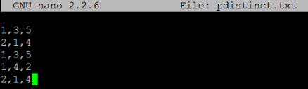

DISTINCT Operator
DISTINCT operator to eliminate duplicate tuples.
Upload the text files on HDFS in the specific directory.
$ hdfs dfs -put pdistinct.txt /pigdemo
Load the file that contains the data.
grunt> A = LOAD '/pigdemo/pdistinct.txt' USING
PigStorage(',') as (a1:int,a2:int,a3:int);
grunt> DUMP A;
grunt> Result = DISTINCT A;

Slide 15
FILTER Operator
Load the file that contains the data.
grunt> A = LOAD '/pigdemo/pfilter.txt' USING
PigStorage(',') AS (a1:int,a2:int);
Grunt> DUMP A;
FILTER operator to eliminate duplicate tuples.
grunt> Result = FILTER A BY a2==8;
Grunt > DUMP Result;

Slide 16
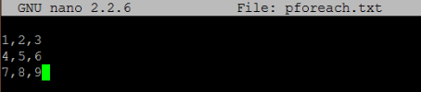

FOREACH Operator
Load the file that contains the data.
grunt> A = LOAD '/pigdemo/pforeach.txt' USING PigStorage(',') AS (a1:int,a2:int,a3:int) ;
Execute and verify the data.
grunt> DUMP A;
Traverse the data of two columns.
grunt> fe = FOREACH A generate a1,a2;
grunt> DUMP fe;

Slide 17
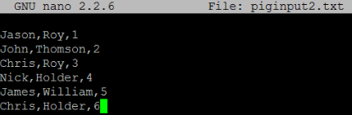

GROUP Operator
Load the data into the bag.
grunt> A = LOAD '/pigdemo/piginput2.txt' USING PigStorage(',')
AS (fname:chararray, l_name:chararray, id:int);
Group the data on the basis of l_name.
grunt> groupbylname = group A by l_name ;
grunt> DUMP groupbylname;

Slide 18
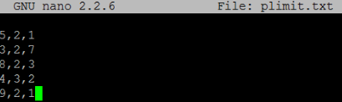

LIMIT Operator
Load the file that contains the data.
grunt> A = LOAD '/pigdemo/plimit.txt' USING PigStorage(',') AS
(a1:int,a2:int,a3:int) ;
Let's return the first two tuples.
grunt> Result = LIMIT A 2;
grunt> DUMP Result;

Slide 19
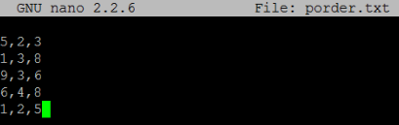
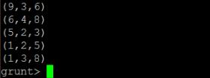
ORDER BY Operator
Load the file that contains the data.
grunt> A = LOAD '/pigdemo/porder.txt' USING PigStorage(',') AS
(a1:int,a2:int,a3:int) ;
Let's return the first two tuples.
grunt> Result = ORDER A BY a1 DESC;
grunt> DUMP Result;

Slide 20

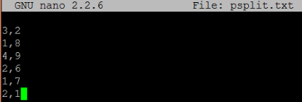

SPLIT Operator
Load the file that contains the data.
grunt> A = LOAD '/pigdemo/psplit.txt' USING PigStorage(',')
AS (a1:int,a2:int) ;
Let's provide the expression to split the relation.
grunt> SPLIT A INTO X IF a1<=2, Y IF a1>2;

Slide 21

UNION Operator
It doesn't maintain the order of tuples and eliminate the duplicate tuples.
Load the file that contains the data.
grunt> A = load '/pigdemo/punion1.txt' using PigStorage
(',') as (a1:int,a2:int);
grunt> B = load '/pigdemo/punion2.txt' using
PigStorage(',') as (b1:int,b2:int,b3:int);
Let's perform the union operation between both files.
grunt> Result = UNION A,B;

Slide 22
EVAL Operator
MIN
MAX
AVG
COUNT
IF
SUM
TOKENIZE
SIZE
CONCAT

Slide 23
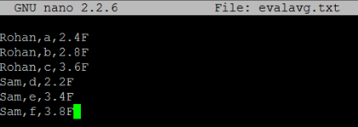

AVG
grunt> A = LOAD '/pigdemo/evalavg.txt' USING PigStorage(',')
AS (a1:chararray, a2:chararray, a3:float)
grunt> DUMP A;
grunt> B = GROUP A BY a1;
grunt> DUMP B;
grunt> Result = FOREACH B GENERATE A.a1, AVG(A.a3);
grunt> DUMP Result;

Slide 24

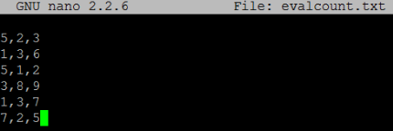

COUNT
grunt> A = LOAD '/pigexample/evalcount.txt' USING PigStorage(',') AS (a1:int,a2:int,a3:int) ;
Group the data on the basis of 'a1' field.
grunt> B = GROUP A BY a1;
grunt> DUMP B;
Return the count of given tuples.
grunt> Result = FOREACH B GENERATE COUNT(A);
grunt> DUMP Result;

Slide 25
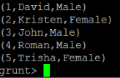

IN Operator
The Apache Pig IN function is used to reduce the requirement for multiple OR conditions.
It facilitates to check if the current expression matches with any value exist in a list.
grunt> Result = FILTER A BY a1 IN (2, 4);
grunt> DUMP Result;

Slide 26
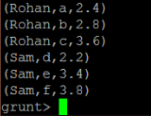


MAX
The Apache Pig MAX function is used to find out the maximum of the numeric values or char arrays in a single-column bag,
It ignores the NULL values.
Let's group the data on the basis of 'a1' field.
grunt> B = GROUP A BY a1;
grunt> Result = FOREACH B GENERATE group, MAX(A.a3);
grunt> DUMP Result;

Slide 27
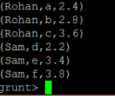

MIN
The Apache Pig MIN function is used to find out the minimum of the numeric values or char arrays in a single-column bag.
It requires a preceding GROUP ALL statement for global minimums and a GROUP BY statement for group minimums.
It ignores the NULL values.
grunt> B = GROUP A BY a1;
grunt> Result = FOREACH B GENERATE group, MIN(A.a3);

Slide 28


SIZE
The Apache Pig SIZE function is used to find the number of elements based on any Pig data type.
It includes NULL values in size computation. Here, the size is not algebraic.
Let's return the size of the first field of each tuple.
grunt> Result = FOREACH A GENERATE SIZE(a1);
grunt> DUMP Result;

Slide 29


TOKENIZE
The Apache Pig TOKENIZE function is used to splits the existing string and generates a bag of words in a result.
grunt> Result = FOREACH A GENERATE TOKENIZE(a1);
grunt> DUMP Result;

Slide 30
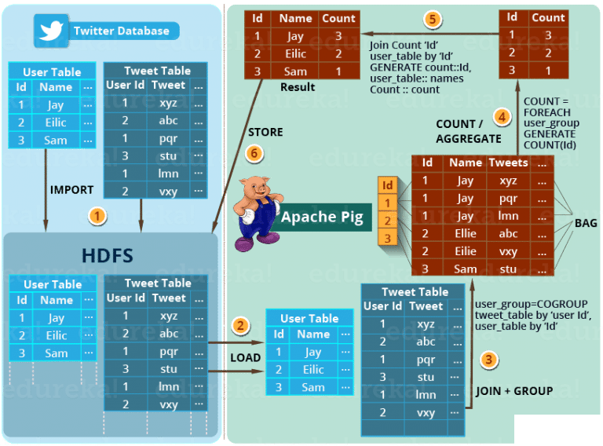
Analyzing how many tweets are stored per user..

Slide 31
Use case: Using Pig find the most occurred start letter
Case 1: Load the data into bag named “lines".
grunt> lines=LOAD "/home/iiitsurat/data.txt" AS (line: chararray);
Case 2: Lines needs to be tokenized this produces one word per row
grunt>tokens = FOREACH lines GENERATE flatten(TOKENIZE
(line) ) AS token: chararray;
Case 3: uses substring method to take the first character.
grunt>letters = FOREACH tokens GENERATE SUBSTRING
(0,1) AS letter : chararray;
Case 4: Create a bag for unique character where the grouped bag will contain the same character for each occurrence of that character.
grunt>lettergrp = GROUP letters by letter;

Slide 32
Contd…
Case 5: The number of occurrence is counted in each group.
grunt>countletter = FOREACH lettergrp GENERATE group , COUNT(letters);
Case 6: Arrange the output according to count in descending order
grunt>OrderCnt = ORDER countletter BY $1 DESC;
Case 7: Limit to One to give the result.
grunt> result =LIMIT OrderCnt 1;
Case 8: Store the result in HDFS
grunt> STORE result into 'home/pig/output';

Slide 33
Contd…
dividends = LOAD ‘NSE_DATA’ as (exchange, symbol, date,
dividend);
grouped = GROUP dividends by symbol;
avg = FOREACH grouped generate group, AVG(dividends.dividend);
DUMP avg;
STORE avg into ‘result’;
demo = FOREACH ‘demo.txt’ GENERATE $7/100, $3 * 100, SUBSTRING ($0, 0, 1), $6-$3;
X = FOREACH demo GENERATE .. A1, A1.. A5;

Slide 34
Schema for Agriculture Dataset
State_Name : chararray ;
District_Name : chararray ;
Crop_Year : int ;
Season : chararray ;
Crop : chararray ;
Area : int ;
Production : int

Slide 35
Questions
Load the dataset in the local mode
Dump and describe the data set agriculture
Grouping All Records State wise.
Generate Total Crop wise Production and Area.
The majority of crops are grown in a Season and in which year.
Average crop production in each district after the year 2000.
Highest produced crops and details from each State.

Slide 36
Answers
grunt > agriculture= LOAD 'F:/csv files/crop_production.csv' using PigStorage (',') as ( State_Name:chararray , District_Name:chararray , Crop_Year:int , Season:chararray , Crop:chararray , Area:int , Production:int ) ;
Dump agriculture;
Describe agriculture;
statewisecrop = GROUP agriculture BY State_Name;

Slide 37
Answers
cropinfo = FOREACH( GROUP agriculture BY Crop ) GENERATE group AS Crop, SUM(agriculture.Area) as AreaPerCrop , SUM(agriculture.Production) as ProductionPerCrop;
seasonalcrops = FOREACH (GROUP agriculture by Season ){ order_crops = ORDER agriculture BY Crop ASC; GENERATE group AS Season , order_crops.(Crop) AS Crops; };
averagecrops = FOREACH (GROUP agriculture by District_Name){ after_year = FILTER agriculture BY Crop_Year>2000; GENERATE group AS District_Name , AVG(after_year.(Production)) AS AvgProd; };

Slide 38
Answers
8. top_agri= GROUP agriculture BY State_Name;
data_top = FOREACH top_agri{ top = TOP(1, 6 , agriculture); GENERATE top as Record; }

